Slide 1
CSC 2224: Parallel Computer Architecture and Programming GPU Architecture: Introduction
Prof. Gennady Pekhimenko
University of Toronto
Fall 2020
The content of this lecture is adapted from the slides of Kayvon Fatahalian (Stanford), Olivier Giroux and Luke Durant (Nvidia), Tor Aamodt (UBC) and Edited by: Serina Tan

Slide 2
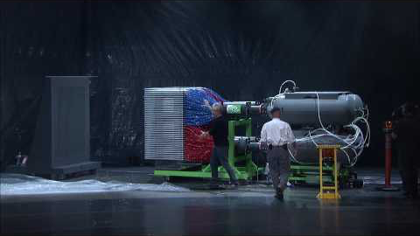
https://www.youtube.com/watch?v=-P28LKWTzrI

Slide 3
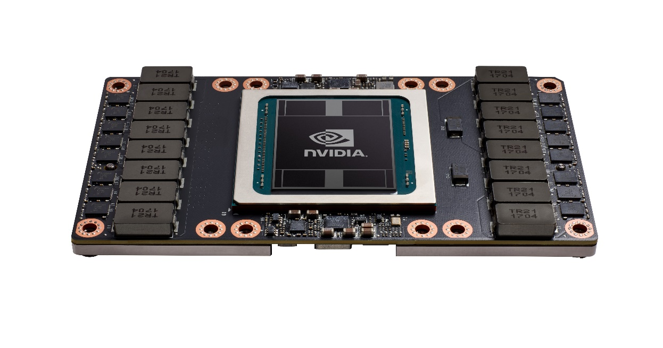
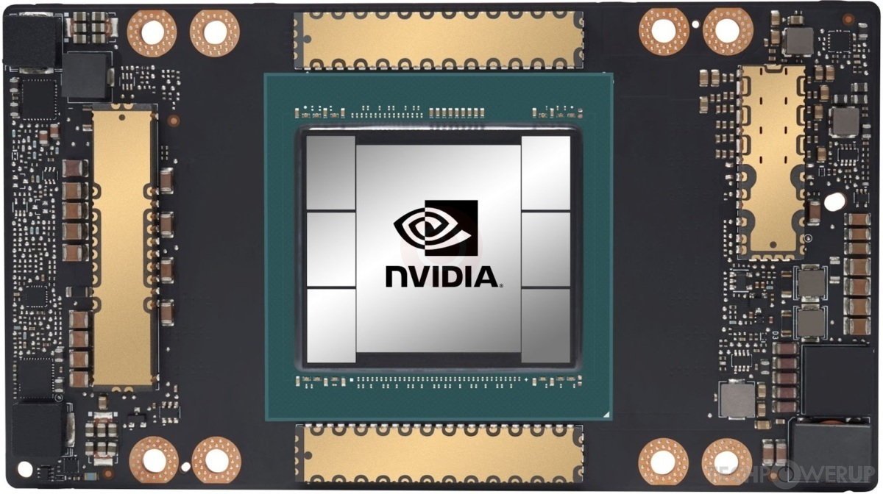
What is a GPU?
GPU = Graphics Processing Unit
Accelerator for raster based graphics (OpenGL, DirectX)
Highly programmable (Turing complete)
Commodity hardware
100’s of ALUs; 10’s of 1000s of concurrent threads
NVIDIA Volta: V100
NVIDIA Volta: A100

Slide 4
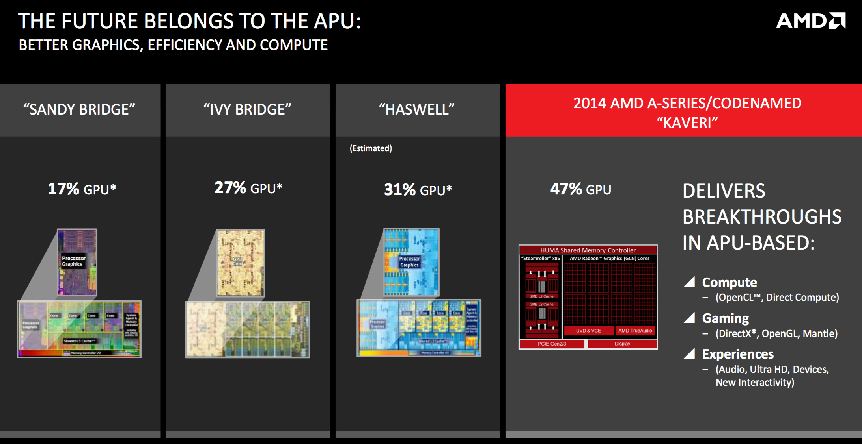
The GPU is Ubiquitous
+
[APU13 keynote]

Slide 5
“Early” GPU History
1981: IBM PC Monochrome Display Adapter (2D)
1996: 3D graphics (e.g., 3dfx Voodoo)
1999: register combiner (NVIDIA GeForce 256)
2001: programmable shaders (NVIDIA GeForce 3)
2002: floating-point (ATI Radeon 9700)
2005: unified shaders (ATI R520 in Xbox 360)
2006: compute (NVIDIA GeForce 8800)
Notes:
GPGPU
Origins
Use in supercomputing
CUDA => OpenCL => C++AMP, OpenACC, others
Use in Smartphones (e.g., Imagination PowerVR)
Cars (e.g., NVIDIA DRIVE PX)

Slide 6
Why use a GPU for computing?
GPU uses larger fraction of silicon for computation than CPU.
At peak performance GPU uses order of magnitude less energy per operation than CPU.
GPU
200pJ/op
CPU
2nJ/op
Rewrite Application
Order of Magnitude More Energy Efficient
However….
Application must perform well

Slide 7
Agenda
Three key ideas that make GPUs run fast
GPU memory hierarchy
Closer look at a modern GPU architecture (Nvidia’s Volta)
Memory: higher bandwidth, larger capacity
Compute: application-specific hardware

Slide 8
Why GPUs Run Fast?
Three key ideas behind how modern GPU processing cores run code
Knowing these concepts will help you:
Understand GPU core designs
Optimize performance of your parallel programs
Gain intuition about what workloads might benefit from such a parallel architecture

Slide 9
Example Program: Vector Multiply-Add
Compute v = a ∙ b + c (a, b, c and v are vectors with a length of N)
a
𝘅
b
void mul_add (int N, float* a, float* b, float* c, float* v) {
for (int i = 0; i < N; i++) {
v[i] = a[i] * b[i] + c[i]
}
}
＋
c
=
v

Slide 10
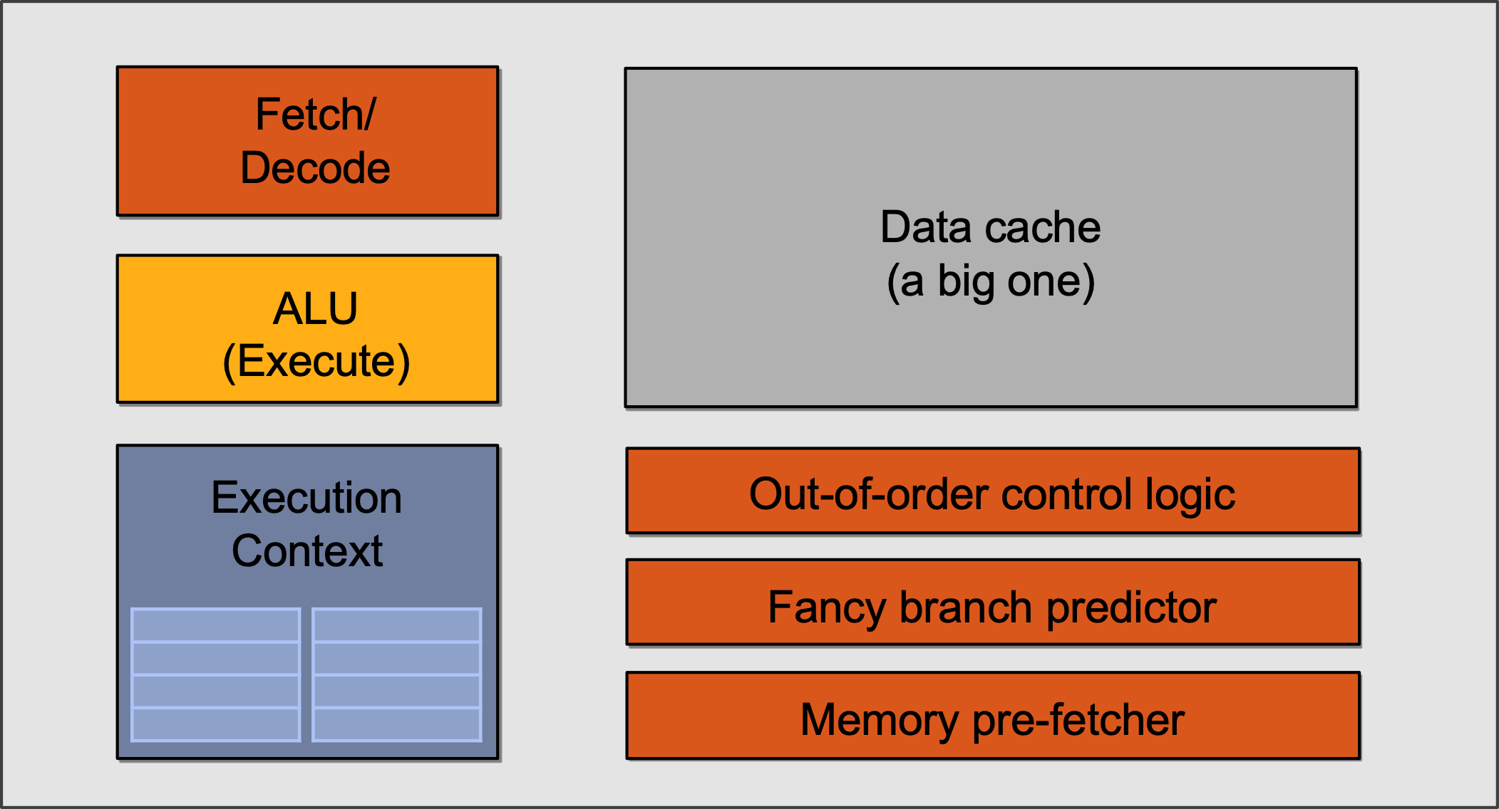
Single-core CPU Execution
mov R1, 0
START:
ld R2, a[R1]
ld R3, b[R1]
ld R4, c[R1]
madd R5, R2, R3, R4
st R5, v[R1]
add R1, R1, 1
bra START if R1 < N

Slide 11
Single-core CPU Execution
mov R1, 0
START:
ld R2, a[R1]
ld R3, b[R1]
ld R4, c[R1]
madd R5, R2, R3, R4
st R5, v[R1]
add R1, R1, 1
bra START if R1 < N
madd stalled,
jump to the next independent instruction
START:
ld R2, a[R1]
ld R3, b[R1]
ld R4, c[R1]
madd R5, R2, R3, R4
st R5, v[R1]
add R1, R1, 1
bra START if R1 < N
Can also be executed out-of-order through register renaming
…
Instruction Flow

Slide 12
Single-core CPU Execution
mov R1, 0
START:
ld R2, a[R1]
ld R3, b[R1]
ld R4, c[R1]
madd R5, R2, R3, R4
st R5, v[R1]
add R1, R1, 1
bra START if R1 < N
But what if we tell the hardware
these two blocks can be executed
in parallel to begin with?
START:
ld R2, a[R1]
ld R3, b[R1]
ld R4, c[R1]
madd R5, R2, R3, R4
st R5, v[R1]
add R1, R1, 1
bra START if R1 < N
…
Instruction Flow

Slide 13
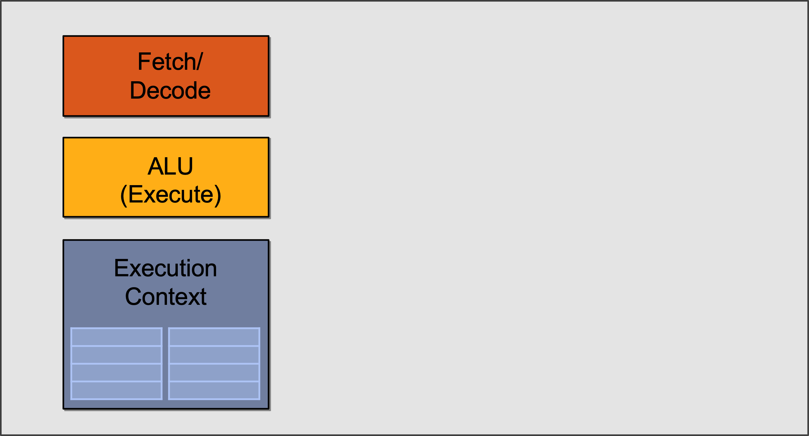
Slimming Down
Idea #1:
Use increasing transistor count to add more cores to the processor
… rather than use transistors to increase sophistication of processor logic that accelerates a single instruction stream (e.g., out-of-order and speculative operations)

Slide 14
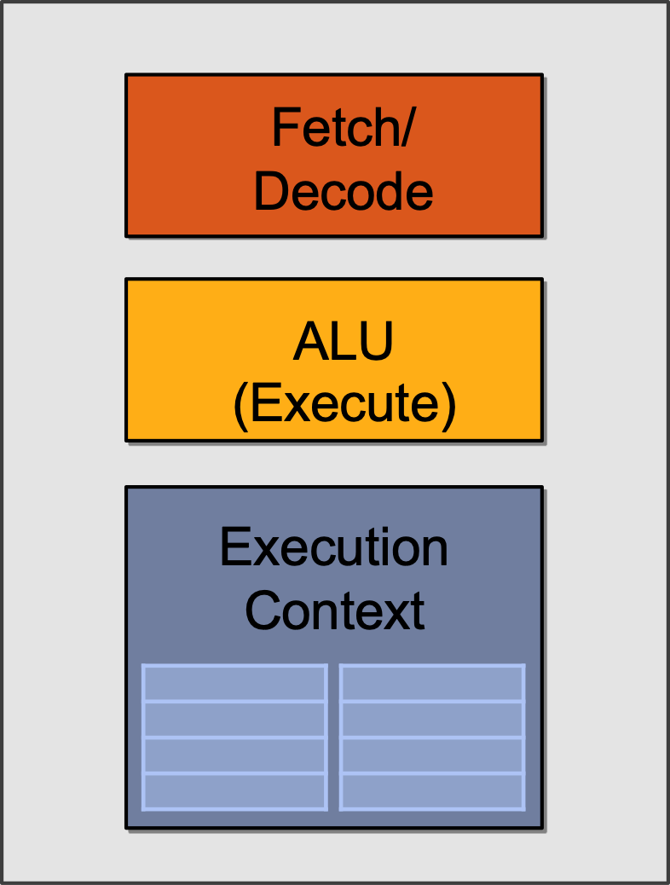
Two cores (Two Elements in Parallel)
Element x
Element y
START:
ld R2, a[R1]
ld R3, b[R1]
ld R4, c[R1]
madd R5, R2, R3, R4
st R5, v[R1]
add R1, R1, 1
START:
ld R2, a[R1]
ld R3, b[R1]
ld R4, c[R1]
madd R5, R2, R3, R4
st R5, v[R1]
add R1, R1, 1
Result x
Result y

Slide 15
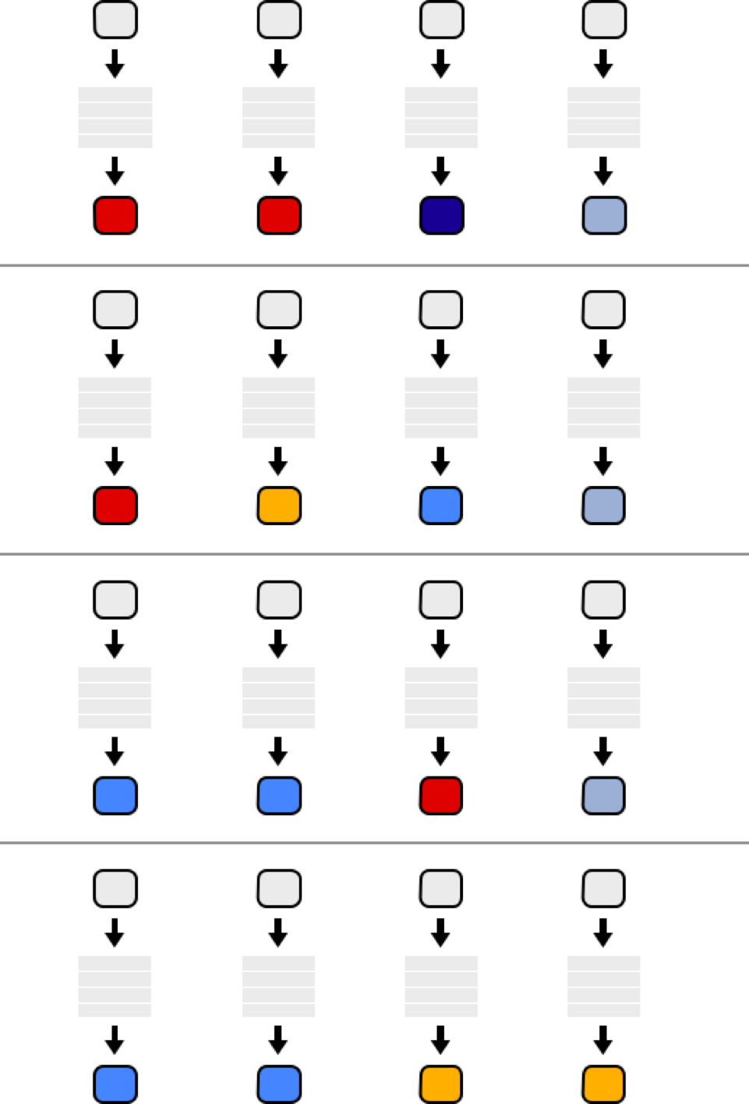
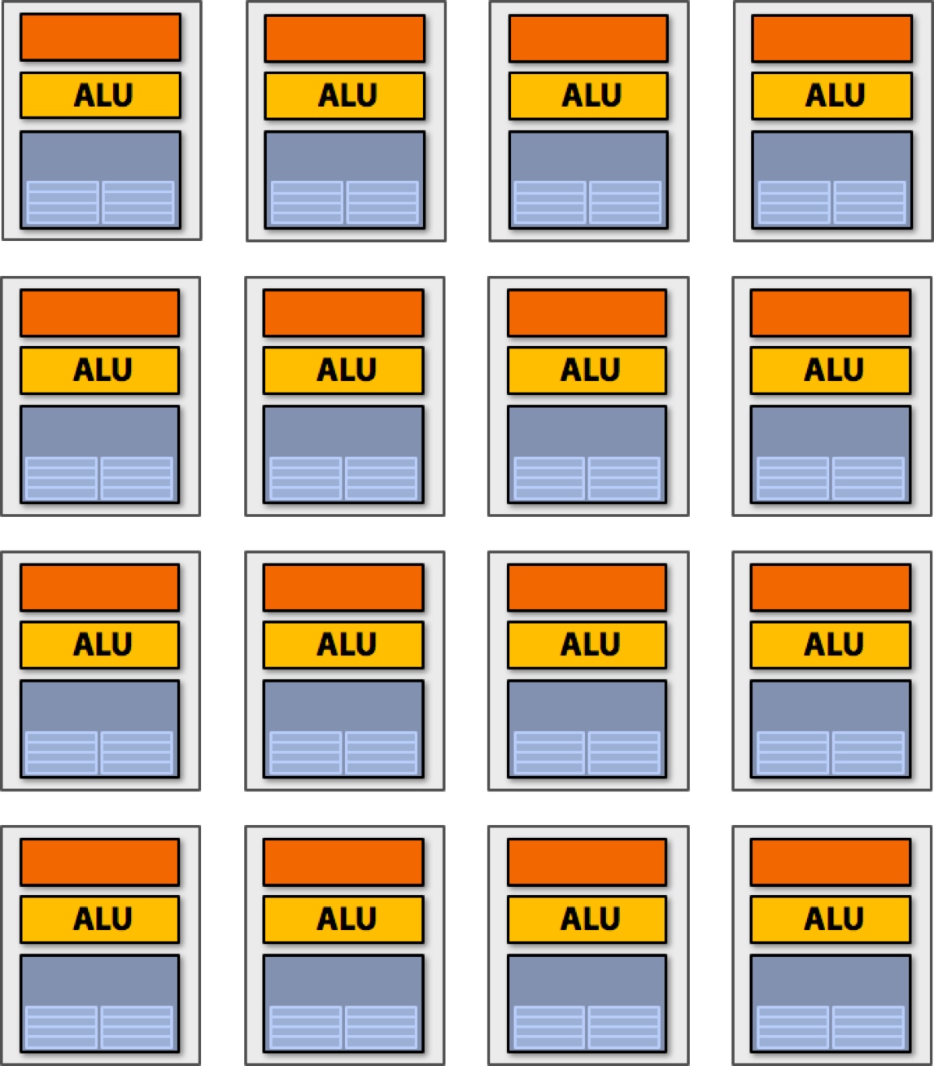
Sixteen Cores
But wait… Different elements in the vector
are running the exact same instructions!
START:
ld R2, a[R1]
ld R3, b[R1]
ld R4, c[R1]
madd R5, R2, R3, R4
st R5, v[R1]
add R1, R1, 1
16 cores = 16 simultaneous instruction streams

Slide 16
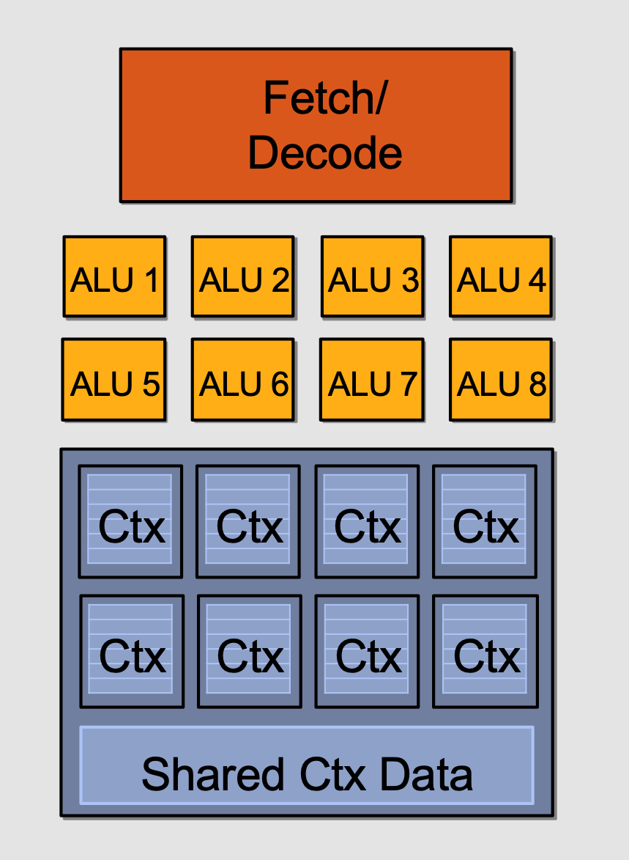
Instruction Stream Sharing
Idea #2:
Amortize cost/complexity of managing an instruction stream across many ALUs
SIMD processing!

Slide 17
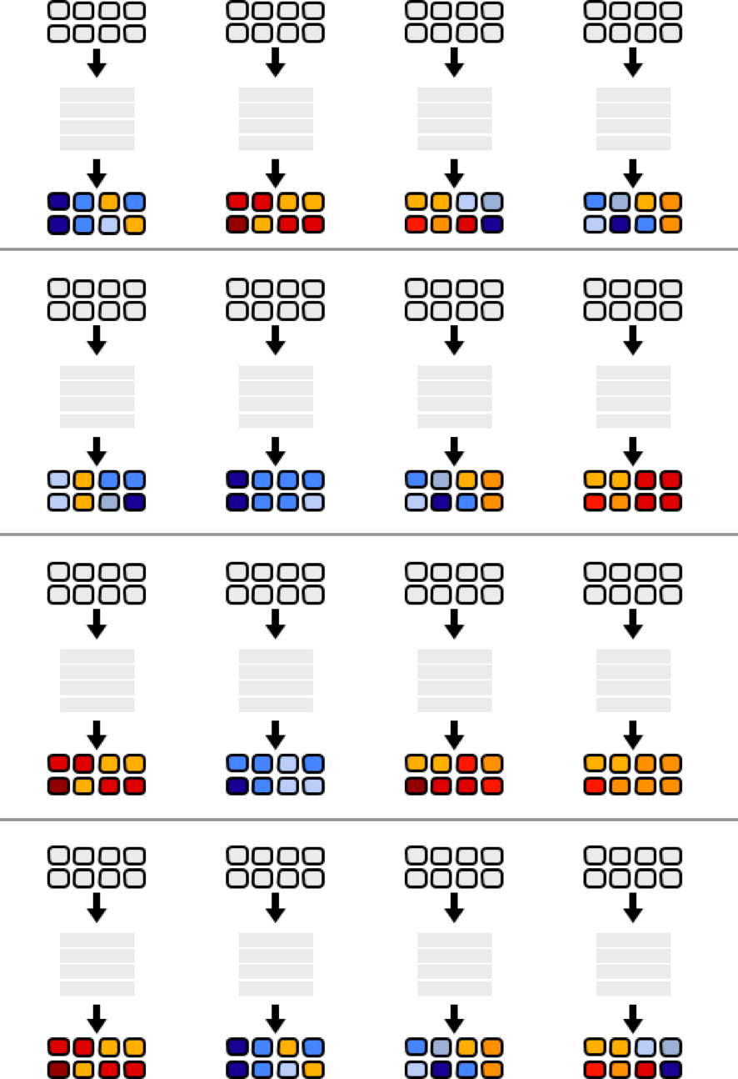
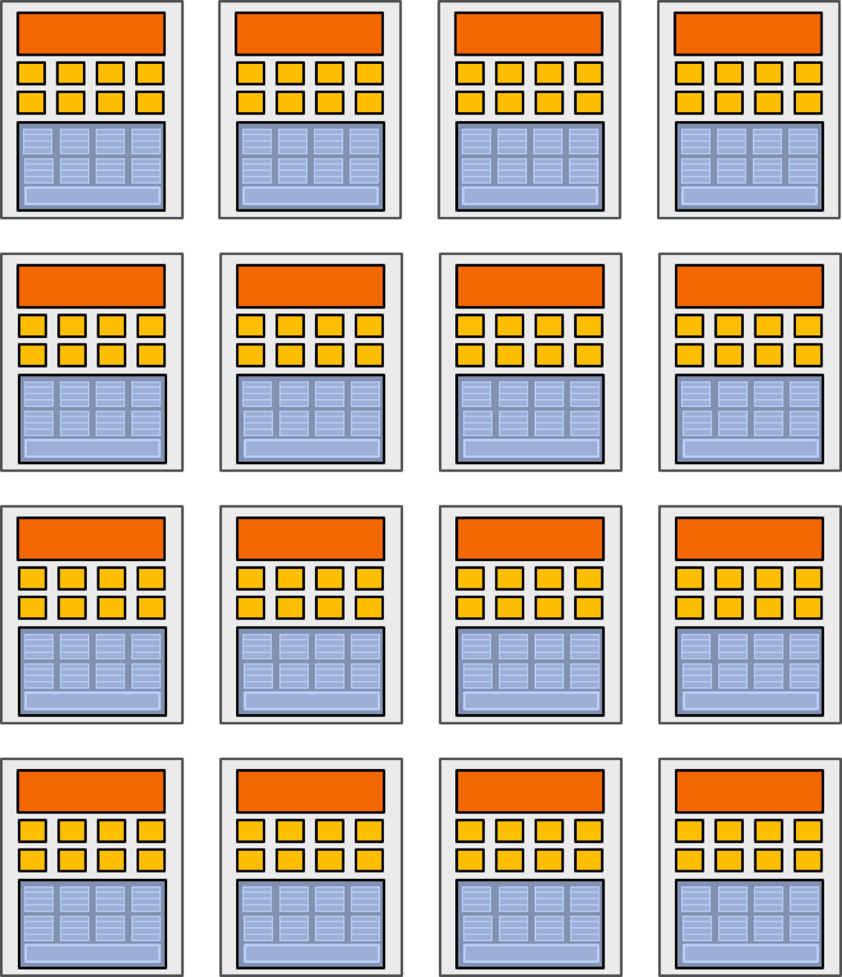
128 Elements in Parallel
16 cores 𝘅 8 ALUs/core = 128 ALUs
16 cores = 16 simultaneous instruction streams

Slide 18
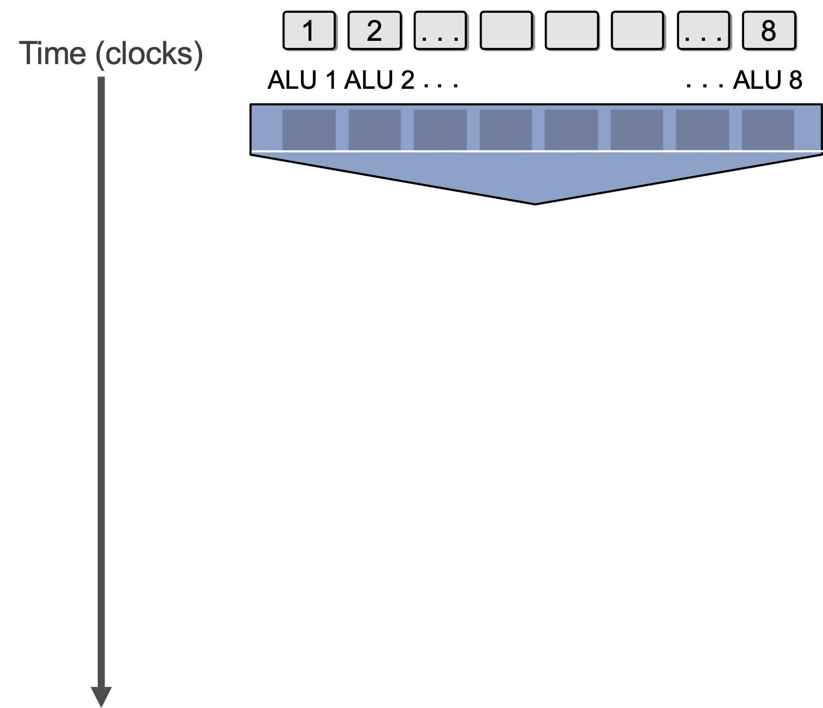
What about Branches?
<unconditional shader code>
if (x > 0) {
y = pow(x, exp);
y *= Ks;
refl = y + Ka;
} else {
x = 0;
refl = Ka;
}
<resume unconditional shader code>

Slide 19
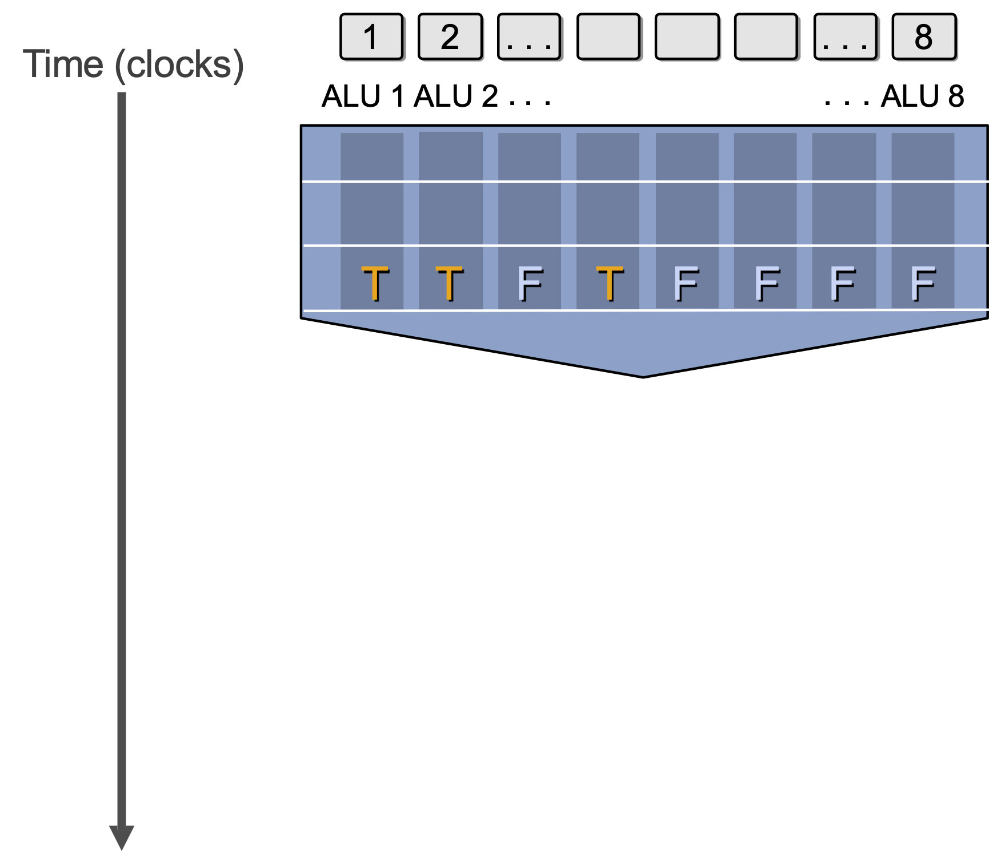
What about Branches?
<unconditional shader code>
if (x > 0) {
y = pow(x, exp);
y *= Ks;
refl = y + Ka;
} else {
x = 0;
refl = Ka;
}
<resume unconditional shader code>

Slide 20
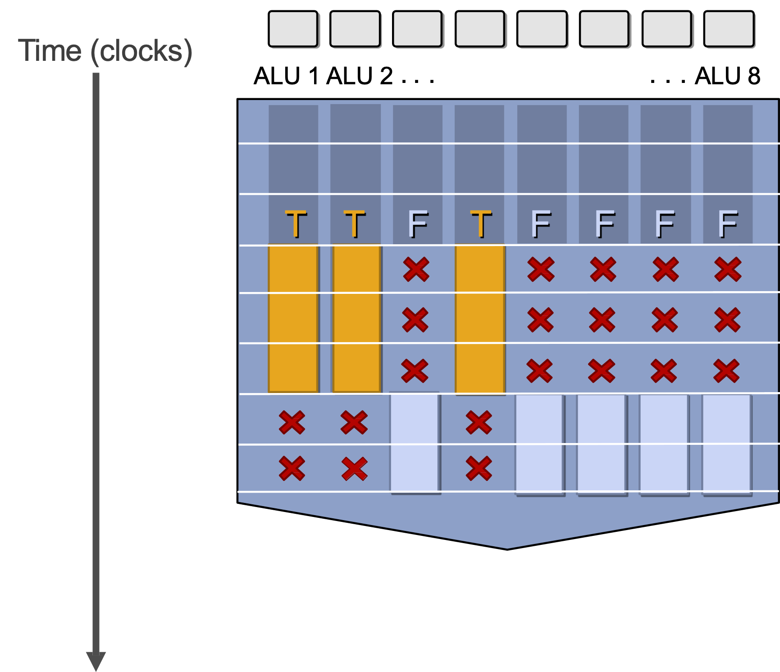
What about Branches?
<unconditional shader code>
if (x > 0) {
y = pow(x, exp);
y *= Ks;
refl = y + Ka;
} else {
x = 0;
refl = Ka;
}
<resume unconditional shader code>
Not all ALUs do useful work!
Worst case: 1/8 peak performance

Slide 21
Terminology
Instruction stream coherence (“coherent execution”)
Same instruction sequence applies to all elements operated upon simultaneously
Coherent execution is necessary for efficient use of SIMD processing resources
Coherent execution IS NOT necessary for efficient parallelization across cores, since each core has the capability to fetch/decode a different instruction stream
“Divergent” execution
A lack of instruction stream coherence

Slide 22
SIMD Execution on Modern GPUs
“Implicit SIMD”
Compiler generates a scalar binary (scalar as opposed to vector instructions)
But N instances of the program are *always running* together on the processor i.e., execute(my_function, N) // execute my_function N times
Hardware (not compiler) is responsible for simultaneously executing the same instruction on different data in SIMD ALUs
SIMD width in practice
32 on NVIDIA GPUs (a warp of threads) and 64 on AMD GPUs (wavefront)
Divergence can be a big issue (poorly written code might execute at 1/32 the peak capability of the machine!)

Slide 23
Dealing with Stalls on In-order Cores
Stalls occur when a core cannot run the next instruction because of a dependency on a previous long-latency operation
We’ve removed fancy logic that helps avoid stalls
No more out-of-order execution to exploit instruction-level parallelism (ILP)
Traditional cache doesn’t always help since a lot of workloads are streaming data
But, we have a LOT of parallel work…
Idea #3: Interleave processing of many warps on a single core to avoid stalls caused by high-latency operations

Slide 24
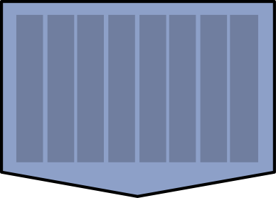
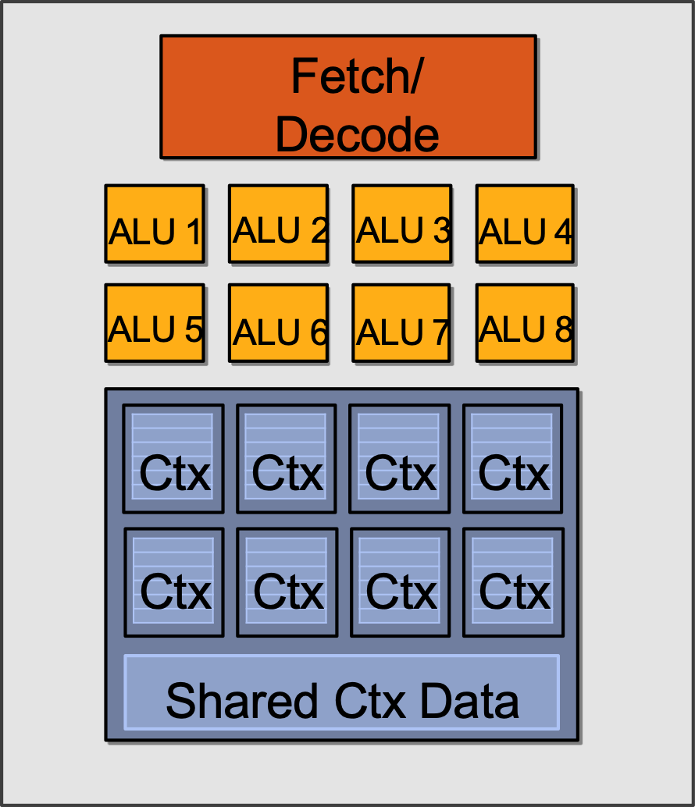
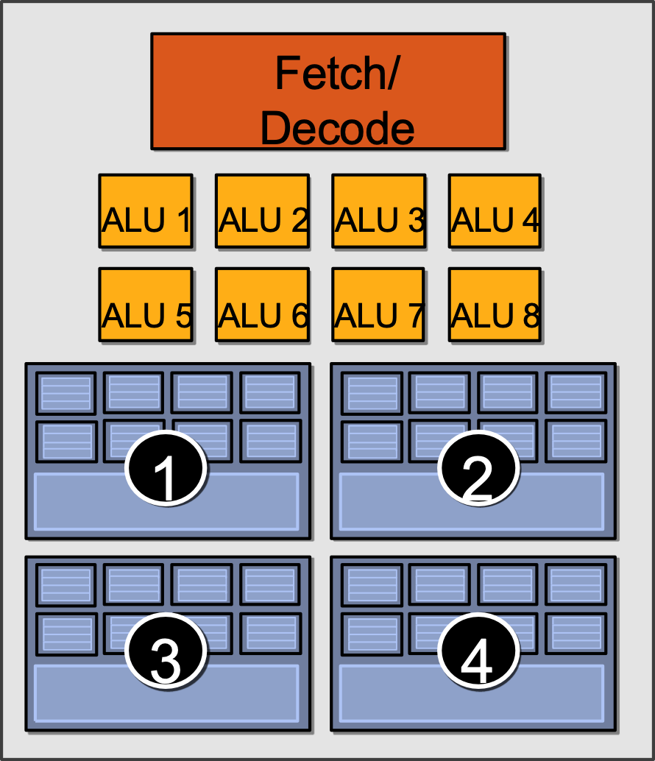
Hiding Stalls
Time
(clock cycles)
Element 1…8
Element 9…16
Element 17…24
Element 25…32
1
2
3
4

Slide 25

Hiding Stalls
Time
(clock cycles)
Element 1…8
Element 9…16
Element 17…24
Element 25…32
1
2
3
4
Runnable

Slide 26
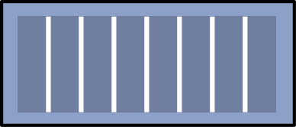
Hiding Stalls
Time
(clock cycles)
Element 1…8
Element 9…16
Element 17…24
Element 25…32
1
2
3
4
Runnable
Runnable
Done!
Runnable
Done!
Runnable
Done!
Done!

Slide 27
Throughput Computing Trade-off
Time
(clock cycles)
Element 1…8
Element 9…16
Element 17…24
Element 25…32
1
2
3
4
Runnable
During this time, this group is runnable, but it is not being executed by the processor. (The core is running some other group.)
Done!
Key idea of throughput-oriented systems:
Potentially increase runtime of one group, in order to increase throughput of overall system running multiple groups.

Slide 28
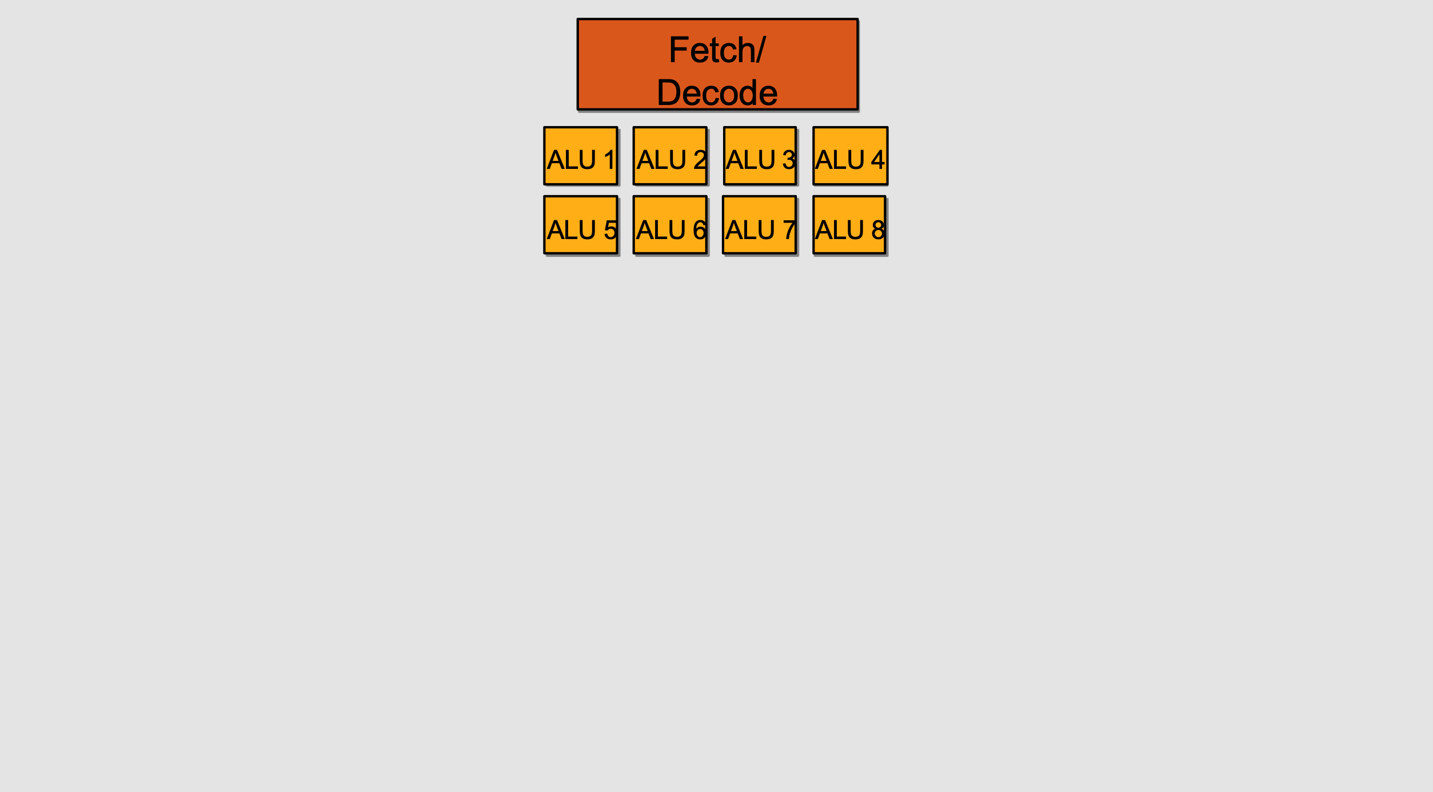
Storing Execution Contexts
Consider on-chip storage of execution contexts a finite resource
Resource consumption of each thread group is program-dependent
Execution Context Storage

Slide 29
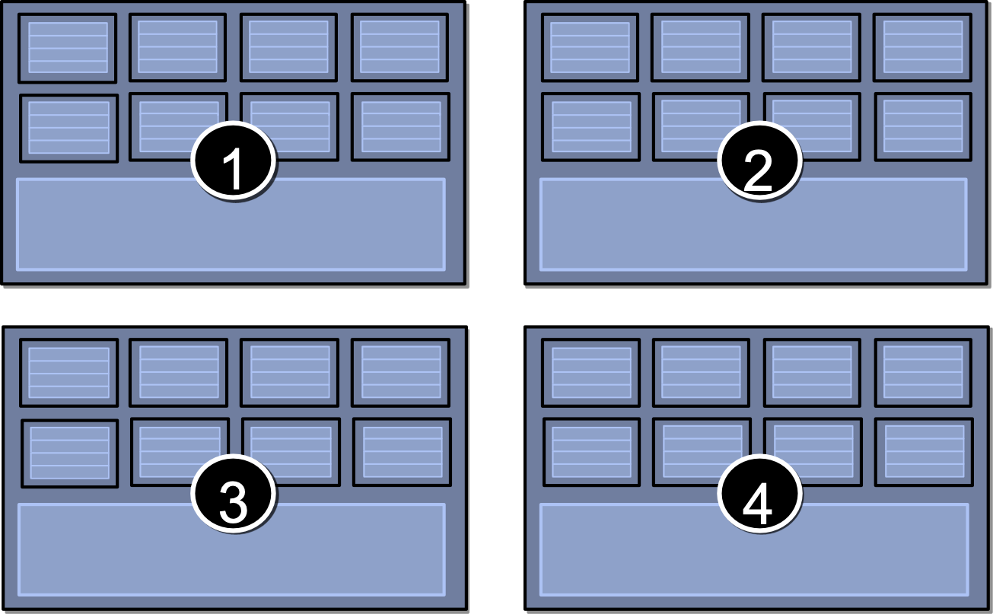
Four Large Contexts (Low Latency Hiding)

Slide 30
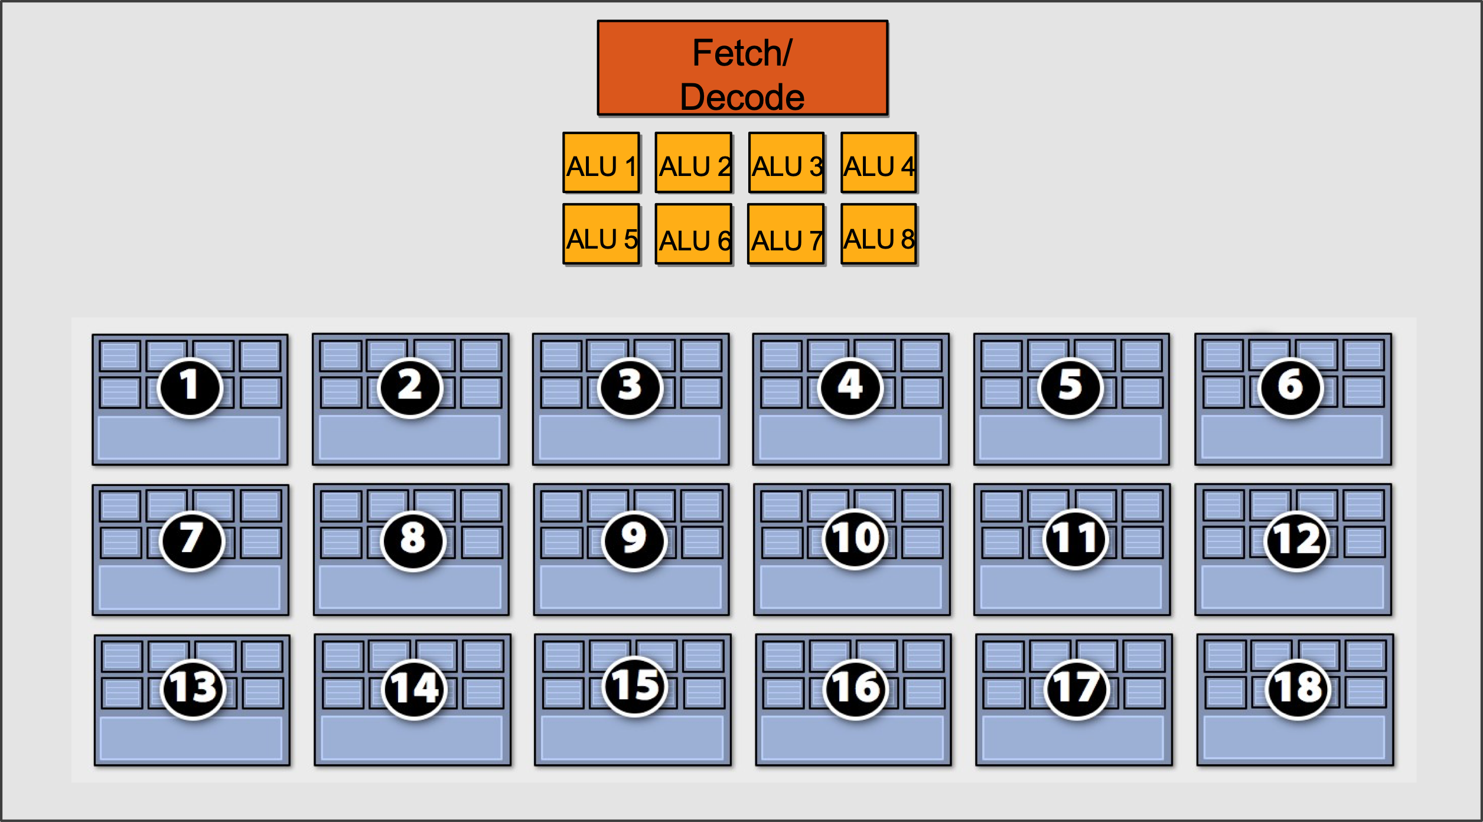
Eighteen Small Contexts (High Latency Hiding)

Slide 31
Summary: Three Key Ideas
Use many “slimmed down cores” to run in parallel
Pack cores full of ALUs (by sharing instruction stream on multiple data)
Avoid latency stalls by interleaving execution of many groups of threads
When one group stalls, work on another group

Slide 32
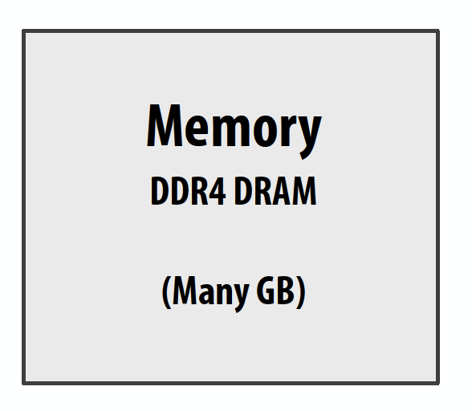
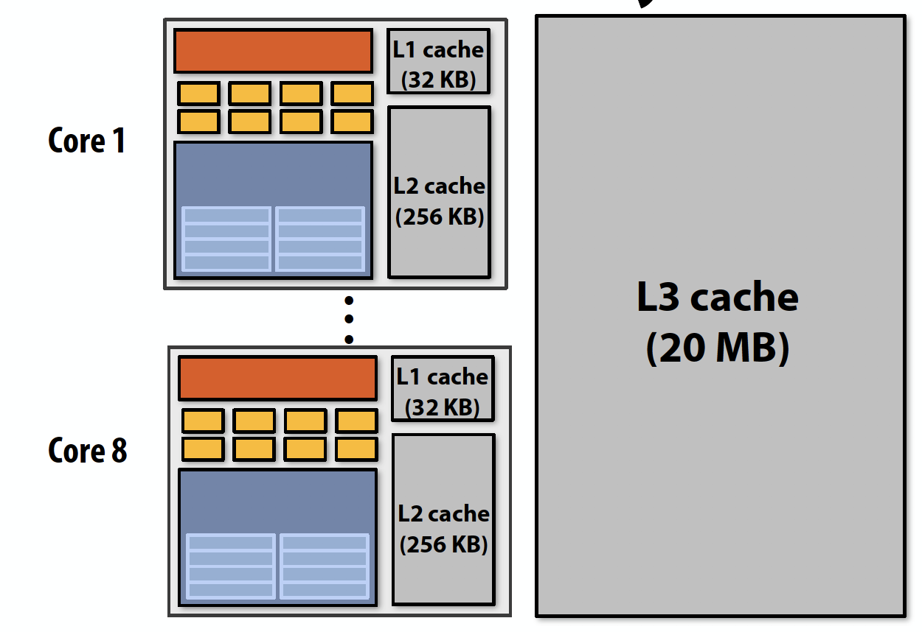
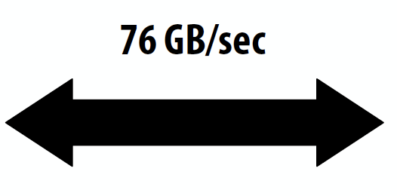
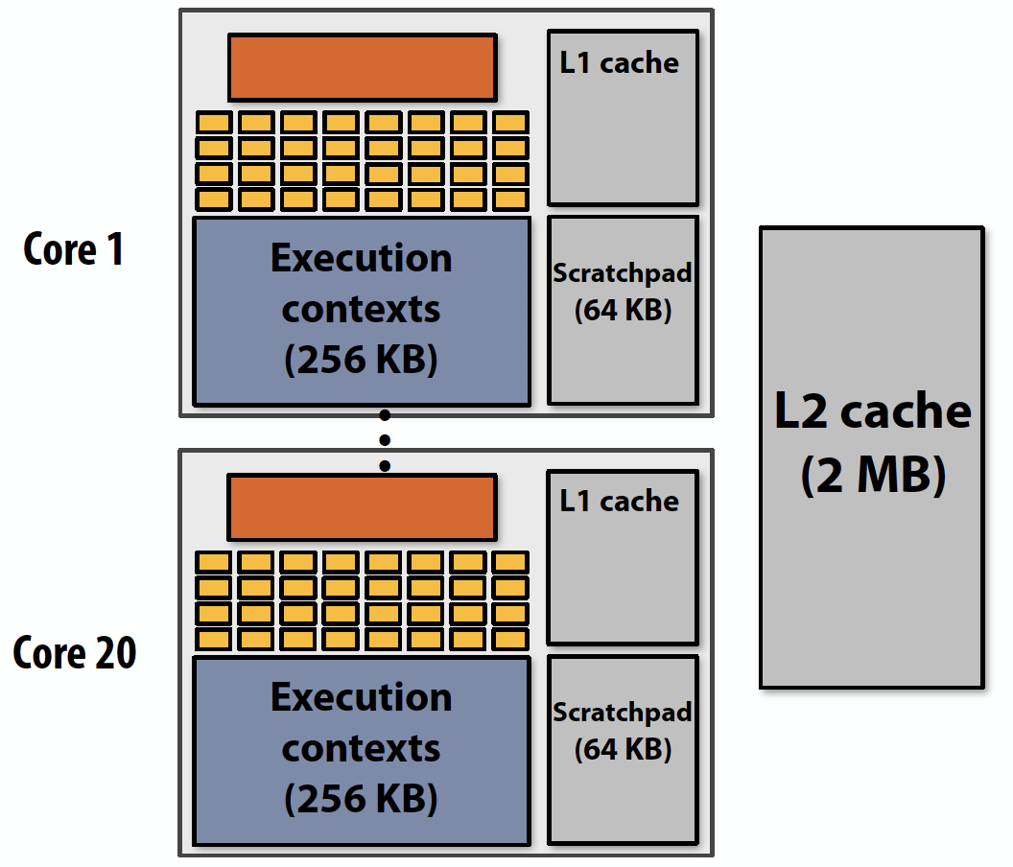
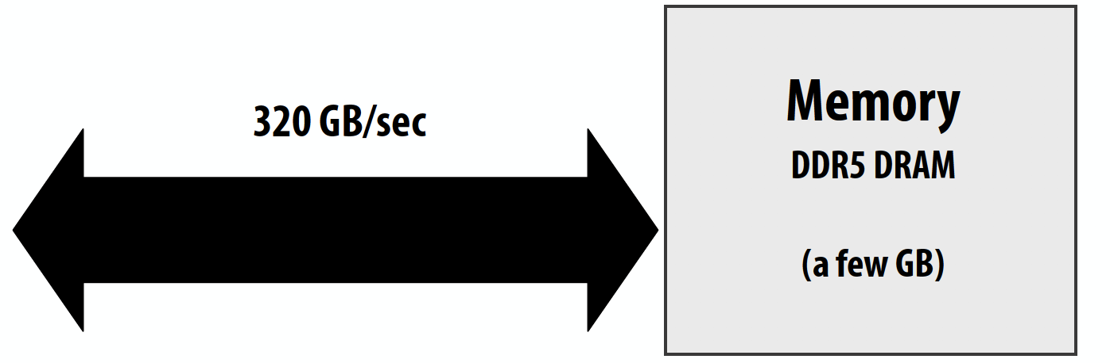
CPU v.s. GPU Memory Hierarchies
CPU:
Big caches, few threads per core, modest memory BW
Rely mainly on caches and prefetching
GDDR5
NVIDIA GTX 1080
(Pascal)
GPU:
Small caches, many threads, huge memory BW
Rely heavily on multi-threading for performance

Slide 33
Thought Experiment
Consider element-wise multiplication of two vectors a and b
Assume vectors contain millions of elements
Load input a[i]
Load input b[i]
Compute a[i] 𝘅 b[i]
Store result into v[i]
Three memory operations (12 bytes) for every MUL
NVIDIA GTX 1080 GPU can do 2560 MULs per clock (@ 1.6 GHz)
Need ~45 TB/sec of bandwidth to keep functional units busy (only have 320 GB/sec)
a
𝘅
b
=
v
<1% GPU efficiency… but 4.2x faster than eight-core CPU in lab!
(3.2 GHz Xeon E5v4 eight-core CPU connected to 76 GB/sec memory bus will exhibit ~3% efficiency on this computation)

Slide 34
Bandwidth limited!
If processors request data at too high a rate, the memory system cannot keep up.
No amount of latency hiding helps this.
Overcoming bandwidth limits are a common challenge for
application developers on throughput-optimized systems.

Slide 35
Bandwidth is a Critical Resource
Performant parallel programs will:
Organize computation to fetch data from memory less often
Reuse data previously loaded by the same thread
Share data across threads through scratchpad (inter-thread cooperation)
Access contiguous memory within the same warp (hardware managed memory coalescing)
Request data less often (instead, do more arithmetic: it’s “free”)
Useful term: “arithmetic intensity” — ratio of math operations to data access operations in an instruction stream
Main point: programs must have high arithmetic intensity to utilize modern processors efficiently

Slide 36
Memory Spaces in GPU
On-chip:
Register file
Usage determined by compiler
Spills go to local memory
Shared memory, i.e. scratchpad
Programmer managed
Bank conflicts
L1 cache
SM 1
SM n
Compute Cores
SM 0
Register File (fast)
Shared Memory (med)
L1 Cache (Slow)
…
Per thread
Per thread block
All resident threads
Off-chip:
L2 cache
Bandwidth filter for DRAM rather than reducing latency as in CPUs
Device memory (DRAM)
Several spaces: global memory, texture memory, local memory
Different spaces have different caching policies
L2 Cache (slow+)
Device Memory (slow++)

Slide 37
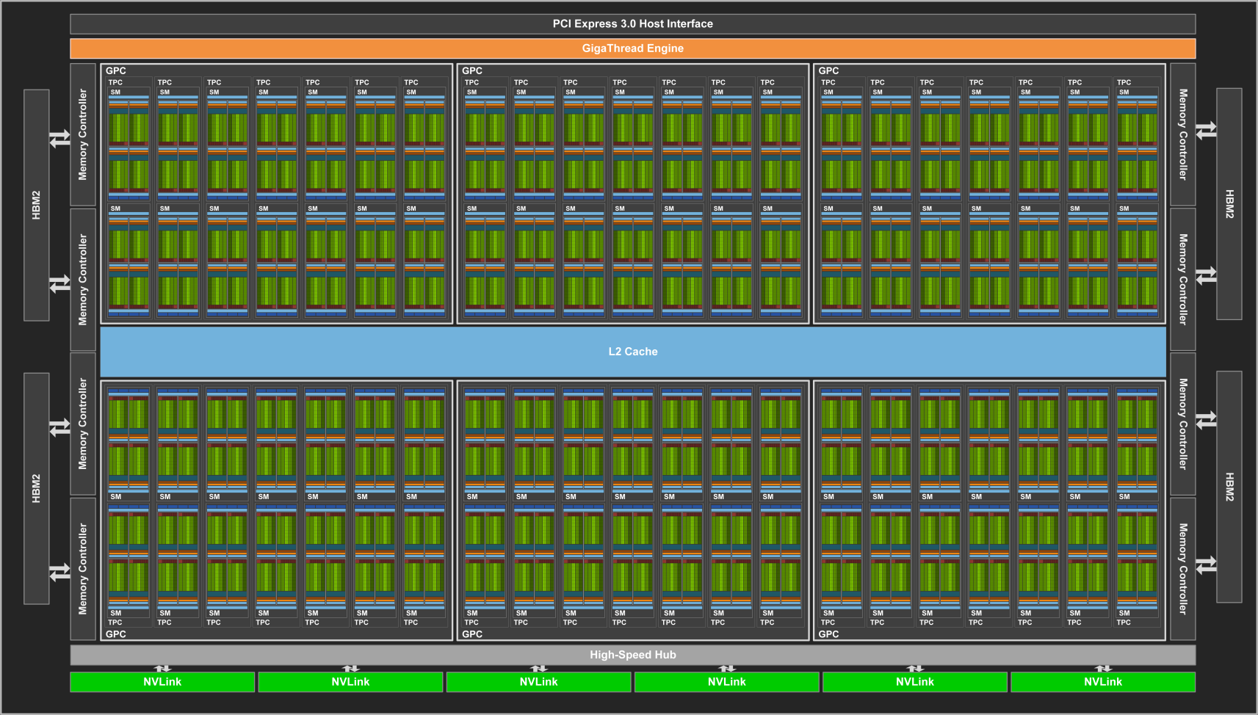

Modern GPU Architecture (Volta 2017)
21B transistors 815 mm²
80 SM
5120 CUDA Cores
640 Tensor Cores
16/32 GB HBM2
900 GB/s HBM2
300 GB/s NVLink
*full GV100 chip contains 84 SMs
37

Slide 38
Review #6
GPUs and the Future of Parallel Computing Steve Keckler et al., IEEE Micro 2011
Due Oct. 22nd

Slide 39
CSC 2224: Parallel Computer Architecture and Programming GPU Architecture: Introduction
Prof. Gennady Pekhimenko
University of Toronto
Fall 2020
The content of this lecture is adapted from the slides of Kayvon Fatahalian (Stanford), Olivier Giroux and Luke Durant (Nvidia), Tor Aamodt (UBC) and Edited by: Serina Tan

Slide 40
CSC 2224: Parallel Computer Architecture and Programming GPU Programming
Prof. Gennady Pekhimenko
University of Toronto
Fall 2020
The content of this lecture is adapted from the slides of Kayvon Fatahalian (Stanford), Olivier Giroux and Luke Durant (Nvidia), Tor Aamodt (UBC) and Edited by: Serina Tan

Slide 41
Memory Allocation and Data Movement API Functions

Slide 42
Objective
To learn the basic API functions in CUDA host code
Device Memory Allocation
Host-Device Data Transfer

Slide 43
Data Parallelism - Vector Addition Example
vector A
A[0]
A[1]
A[2]
…
A[N-1]
vector B
B[0]
B[1]
B[2]
…
B[N-1]
+
+
+
+
vector C
C[0]
C[1]
C[2]
…
C[N-1]

Slide 44
Vector Addition – Traditional C Code
// Compute vector sum C = A + B
void vecAdd(float *h_A, float *h_B, float *h_C, int n)
{
int i;
for (i = 0; i<n; i++) h_C[i] = h_A[i] + h_B[i];
}
int main()
{
// Memory allocation for h_A, h_B, and h_C
// I/O to read h_A and h_B, N elements
…
vecAdd(h_A, h_B, h_C, N);
}

Slide 45
Heterogeneous Computing vecAdd CUDA Host Code
Part 1
#include <cuda.h>
void vecAdd(float *h_A, float *h_B, float *h_C, int n)‏
{
int size = n* sizeof(float);
float *d_A, *d_B, *d_C;
// Part 1
// Allocate device memory for A, B, and C
// copy A and B to device memory
// Part 2
// Kernel launch code – the device performs the actual vector addition
// Part 3
// copy C from the device memory
// Free device vectors
}
Host Memory
Device Memory
CPU
GPU
Part 3

Slide 46
Partial Overview of CUDA Memories
Device code can:
R/W per-thread registers
R/W all-shared global memory
Host code can
Transfer data to/from per grid global memory
(Device) Grid
Block (0, 0)
Block (0, 1)
Thread (0, 0)
Thread (0, 1)
Thread (0, 0)
Thread (0, 1)
Registers
Registers
Registers
Registers
Host
Global
Memory
We will cover more memory types and more sophisticated memory models later.
Notes:
Global, constant, and texture memory spaces are persistent across kernels called by the same application.

Slide 47
CUDA Device Memory Management API functions
cudaMalloc()
Allocates an object in the device global memory
Two parameters
Address of a pointer to the allocated object
Size of allocated object in terms of bytes
cudaFree()
Frees object from device global memory
One parameter
Pointer to freed object
(Device) Grid
Block (0, 0)
Block (0, 1)
Thread (0, 0)
Thread (0, 1)
Thread (0, 0)
Thread (0, 1)
Registers
Registers
Registers
Registers
Host
Global
Memory

Slide 48
Host-Device Data Transfer API functions
cudaMemcpy()
memory data transfer
Requires four parameters
Pointer to destination
Pointer to source
Number of bytes copied
Type/Direction of transfer
Transfer to device is asynchronous
(Device) Grid
Block (0, 0)
Block (0, 1)
Thread (0, 0)
Thread (0, 1)
Thread (0, 0)
Thread (0, 1)
Registers
Registers
Registers
Registers
Host
Global
Memory

Slide 49
Vector Addition Host Code
void vecAdd(float *h_A, float *h_B, float *h_C, int n)
{
int size = n * sizeof(float); float *d_A, *d_B, *d_C;
cudaMalloc((void **) &d_A, size);
cudaMemcpy(d_A, h_A, size, cudaMemcpyHostToDevice);
cudaMalloc((void **) &d_B, size);
cudaMemcpy(d_B, h_B, size, cudaMemcpyHostToDevice);
cudaMalloc((void **) &d_C, size);
// Kernel invocation code – to be shown later
cudaMemcpy(h_C, d_C, size, cudaMemcpyDeviceToHost);
cudaFree(d_A); cudaFree(d_B); cudaFree (d_C);
}

Slide 50
In Practice, Check for API Errors in Host Code
cudaError_t err = cudaMalloc((void **) &d_A, size);
if (err != cudaSuccess) {
printf(“%s in %s at line %d\n”, cudaGetErrorString(err), __FILE__,
__LINE__);
exit(EXIT_FAILURE);
}

Slide 51
Threads and Kernel Functions

Slide 52
Objective
To learn about CUDA threads, the main mechanism for exploiting of data parallelism
Hierarchical thread organization
Launching parallel execution
Thread index to data index mapping

Slide 53
Data Parallelism - Vector Addition Example
vector A
A[0]
A[1]
A[2]
…
A[N-1]
vector B
B[0]
B[1]
B[2]
…
B[N-1]
+
+
+
+
vector C
C[0]
C[1]
C[2]
…
C[N-1]

Slide 54
CUDA Execution Model
Heterogeneous host (CPU) + device (GPU) application C program
Serial parts in host C code
Parallel parts in device SPMD kernel code
Serial Code (host)‏
Parallel Kernel (device)‏
KernelA<<< nBlk, nTid >>>(args);
. . .
Serial Code (host)‏
Parallel Kernel (device)‏
KernelB<<< nBlk, nTid >>>(args);
. . .

Slide 55
A Thread as a Von-Neumann Processor
A thread is a “virtualized” or “abstracted”
Von-Neumann Processor
Memory
I/O
Processing Unit
Reg
File
ALU
Control Unit
PC
IR
Notes:
Insert von-neumann schematic here

Slide 56
Arrays of Parallel Threads
A CUDA kernel is executed by a grid (array) of threads
All threads in a grid run the same kernel code (Single Program Multiple Data)‏
Each thread has indexes that it uses to compute memory addresses and make control decisions
0
1
2
254
255
…
i = blockIdx.x * blockDim.x + threadIdx.x;
C[i] = A[i] + B[i];
…

Slide 57
Thread Blocks: Scalable Cooperation
Thread Block 0
Thread Block 1
Thread Block N-1
0
1
2
254
255
0
1
2
254
255
0
1
2
254
255
…
…
…
i = blockIdx.x * blockDim.x + threadIdx.x;
C[i] = A[i] + B[i];
i = blockIdx.x * blockDim.x + threadIdx.x;
C[i] = A[i] + B[i];
i = blockIdx.x * blockDim.x + threadIdx.x;
C[i] = A[i] + B[i];
…
…
…
…
Divide thread array into multiple blocks
Threads within a block cooperate via shared memory, atomic operations on shared/global memory addresses and barrier synchronization
Threads in different blocks do not interact (except for atomic operations on global memory addresses)

Slide 58
blockIdx and threadIdx
Each thread uses indices to decide what data to work on
blockIdx: 1D, 2D, or 3D (CUDA 4.0)
threadIdx: 1D, 2D, or 3D
Simplifies memory addressing when processing multidimensional data
Image processing
Solving PDEs on volumes
…
device
Grid
Block (0, 0)
Block (0, 1)
Block (1, 0)
Block (1, 1)
Block (1,1)
(1,0,0)
(1,0,1)
(1,0,2)
(1,0,3)
Thread
(0,0,0)
Thread
(0,0,1)
Thread
(0,0,2)
Thread
(0,0,3)
Thread
(0,0,0)
Thread
(0,1,3)
Thread
(0,1,0)
Thread
(0,1,1)
Thread
(0,1,2)

Slide 59
CUDA Parallelism Model
Kernel-Based SPMD Parallel Programming

Slide 60
Objective
To learn the basic concepts involved in a simple CUDA kernel function
Declaration
Built-in variables
Thread index to data index mapping

Slide 61
Example: Vector Addition Kernel
// Compute vector sum C = A + B
// Each thread performs one pair-wise addition
__global__
void vecAddKernel(float* A, float* B, float* C, int n)
{
int i = threadIdx.x+blockDim.x*blockIdx.x;
if(i<n) C[i] = A[i] + B[i];
}
Device Code

Slide 62
Example: Vector Addition Kernel Launch (Host Code)
Host Code
void vecAdd(float* h_A, float* h_B, float* h_C, int n)
{
// d_A, d_B, d_C allocations and copies omitted
// Run ceil(n/256.0) blocks of 256 threads each
vecAddKernel<<<ceil(n/256.0),256>>>(d_A, d_B, d_C, n);
}
The ceiling function makes sure that there are enough threads to cover all elements.
4

Slide 63
More on Kernel Launch (Host Code)
Host Code
void vecAdd(float* h_A, float* h_B, float* h_C, int n)
{
dim3 DimGrid((n-1)/256 + 1, 1, 1);
dim3 DimBlock(256, 1, 1);
vecAddKernel<<<DimGrid,DimBlock>>>(d_A, d_B, d_C, n);
}
This is an equivalent way to express the ceiling function.

Slide 64
Kernel execution in a nutshell
__host__
void vecAdd(…)
{
dim3 DimGrid(ceil(n/256.0),1,1);
dim3 DimBlock(256,1,1);
vecAddKernel<<<DimGrid,DimBlock>>>(d_A,d_B,d_C,n);
}
__global__
void vecAddKernel(float *A,
float *B, float *C, int n)
{
int i = blockIdx.x * blockDim.x
+ threadIdx.x;
if( i<n ) C[i] = A[i]+B[i];
}
Blk 0
Grid
Blk N-1
• • •
GPU
M0
• • •
Mk
RAM

Slide 65

More on CUDA Function Declarations
Executed on the:
Only callable from the:
__device__ float DeviceFunc()‏
device
device
__global__ void KernelFunc()‏
device
host
__host__ float HostFunc()‏
host
host
__global__ defines a kernel function
Each “__” consists of two underscore characters
A kernel function must return void
__device__ and __host__ can be used together
__host__ is optional if used alone

Slide 66
Compiling A CUDA Program
Integrated C programs with CUDA extensions
NVCC Compiler
Host Code
Device Code (PTX)
Host C Compiler/ Linker
Device Just-in-Time Compiler
Heterogeneous Computing Platform with
CPUs, GPUs, etc.

Slide 67
Multidimensional Kernel Configuration

Slide 68
Objective
To understand multidimensional Grids
Multi-dimensional block and thread indices
Mapping block/thread indices to data indices
2

Slide 69
A Multi-Dimensional Grid Example
host
device
Grid 1
Block (0, 0)
Block (0, 1)
Kernel 1
Block (1, 0)
Block (1, 1)
Block (1,0)
Grid 2
(1,0,0)
(1,0,1)
(1,0,2)
(1,0,3)
Thread
(0,0,0)
Thread
(0,0,1)
Thread
(0,0,2)
Thread
(0,0,3)
Thread
(0,0,0)
Thread
(0,1,3)
Thread
(0,1,0)
Thread
(0,1,1)
Thread
(0,1,2)
69
Note: Block index: (y, x), Thread index: (z, y, x)

Slide 70
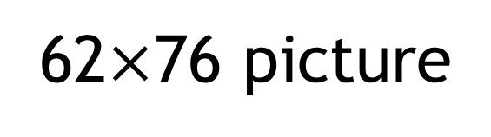


Slide 71
Row-Major Layout in C/C++
M
Row*Width+Col = 2*4+1 = 9
M₀
M₁
M₂
M₃
M₄
M₅
M₆
M₇
M₈
M₉
M₁₀
M₁₁
M₁₂
M₁₃
M₁₄
M₁₅
M
M_{0,0}
M_{0,1}
M_{0,2}
M_{0,3}
M_{1,0}
M_{1,1}
M_{1,2}
M_{1,3}
M_{2,0}
M_{2,1}
M_{2,2}
M_{2,3}
M_{3,0}
M_{3,1}
M_{3,2}
M_{3,3}
M_{0,0}
M_{0,1}
M_{0,2}
M_{0,3}
M_{1,0}
M_{1,1}
M_{1,2}
M_{1,3}
M_{2,0}
M_{2,1}
M_{2,2}
M_{2,3}
M_{3,0}
M_{3,1}
M_{3,2}
M_{3,3}

Slide 72
Source Code of a PictureKernel
__global__ void PictureKernel(float* d_Pin, float* d_Pout,
int height, int width)
{
// Calculate the row # of the d_Pin and d_Pout element
int Row = blockIdx.y*blockDim.y + threadIdx.y;
// Calculate the column # of the d_Pin and d_Pout element
int Col = blockIdx.x*blockDim.x + threadIdx.x;
// each thread computes one element of d_Pout if in range
if ((Row < height) && (Col < width)) {
d_Pout[Row*width+Col] = 2.0*d_Pin[Row*width+Col];
}
}
Scale every pixel value by 2.0

Slide 73
Host Code for Launching PictureKernel
// assume that the picture is m$×$n,
// m pixels in y dimension and n pixels in x dimension
// input d_Pin has been allocated on and copied to device
// output d_Pout has been allocated on device
…
dim3 DimGrid((n-1)/16 + 1, (m-1)/16+1, 1);
dim3 DimBlock(16, 16, 1);
PictureKernel<<<DimGrid,DimBlock>>>(d_Pin, d_Pout, m, n);
…

Slide 74
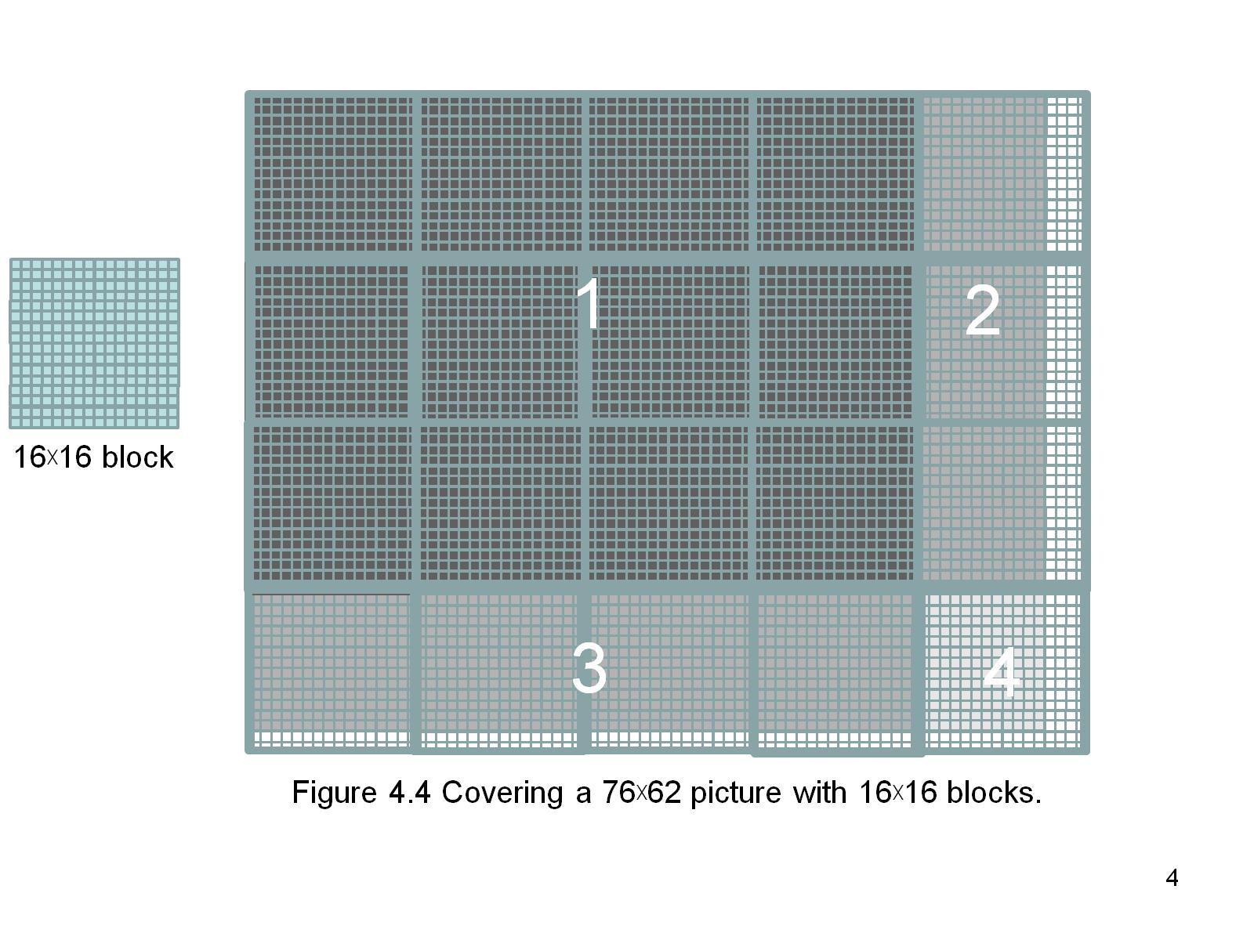
Covering a 62$×$76 Picture with 16$×$16 Blocks
Not all threads in a Block will follow the same control flow path.

Slide 75
CSC 2224: Parallel Computer Architecture and Programming GPU Architecture: Introduction
Prof. Gennady Pekhimenko
University of Toronto
Fall 2020
The content of this lecture is adapted from the slides of Kayvon Fatahalian (Stanford), Olivier Giroux and Luke Durant (Nvidia), Tor Aamodt (UBC) and Edited by: Serina Tan

